Slide 1
e

Slide 2


the Course
Session 1
Grounding -
What is marketing
The Course
Understanding Critical Concepts in marketing
Session 2
Critical Concepts
Needs, wants, Demands
Consumer vs Customer
Marketing Environment
Session 3
Consumer Behavior
Neuroscience
Consumer Buying Behavior – Consumer Bias
Consumer Funnels
Knowing Consumers Better
Session 4
Target Consumer
Segmenting & Targeting
Pen Profiles
Understanding Motivations
Session 5
Customer value
Types of Benefits
Differentiation
Positioning

Slide 3


We need to define User TG and Anchor TG?

Slide 4
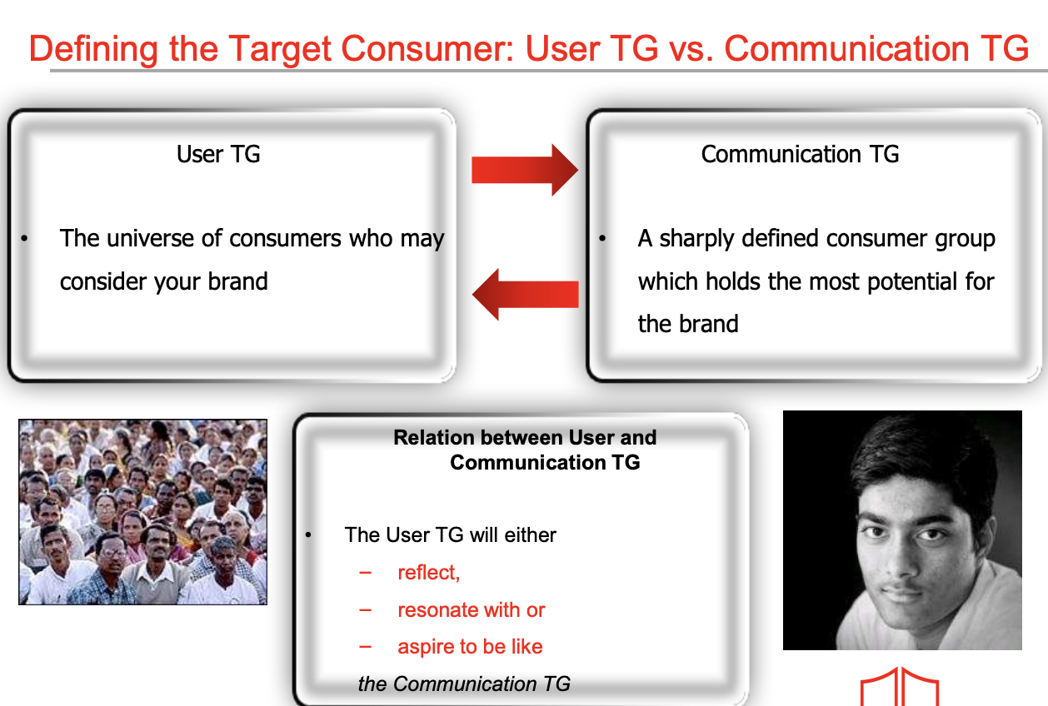
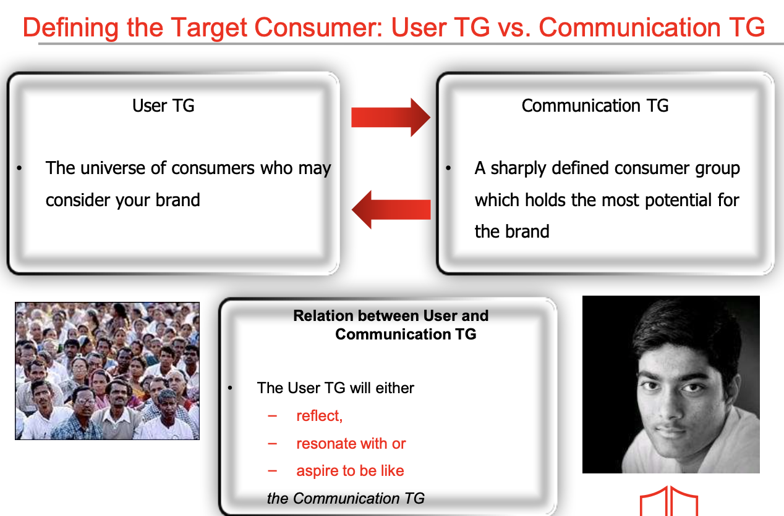
Notes:
Anchor TG (Target Group)
This is the aspirational consumer that the brand uses to define its codes, tonality, and cultural positioning. They may not form the bulk of your sales, but they give the brand meaning, status, and stretch. They are often younger, trend-setting, or more culturally influential.
User TG (Target Group)
This is the actual consumer base—the people who buy and use the product in real life. They may be older, more mass, or less “cool,” but they bring in the revenue and scale.
Nike: Anchor TG = elite athletes & sneakerheads; User TG = everyday fitness enthusiasts worldwide.
Apple: Anchor TG = creative professionals, designers, innovators; User TG = global mass of smartphone and laptop users.
Red Bull: Anchor TG = extreme sports athletes, adventure junkies; User TG = students, young professionals, late-night workers.
Luxury cars (like Mercedes): Anchor TG = young achievers who signify success; User TG = established wealthy middle-aged buyers.

Slide 5
Anchor TG (Target Group)
This is the aspirational consumer that the brand uses to define its codes, tonality, and cultural positioning. They may not form the bulk of your sales, but they give the brand meaning, status, and stretch. They are often younger, trend-setting, or more culturally influential.
User TG (Target Group)
This is the actual consumer base—the people who buy and use the product in real life. They may be older, more mass, or less “cool,” but they bring in the revenue and scale.
Nike: Anchor TG = elite athletes & sneakerheads; User TG = everyday fitness enthusiasts worldwide.
Apple: Anchor TG = creative professionals, designers, innovators; User TG = global mass of smartphone and laptop users.
Red Bull: Anchor TG = extreme sports athletes, adventure junkies; User TG = students, young professionals, late-night workers.
Luxury cars (like Mercedes): Anchor TG = young achievers who signify success; User TG = established wealthy middle-aged buyers.

Slide 6
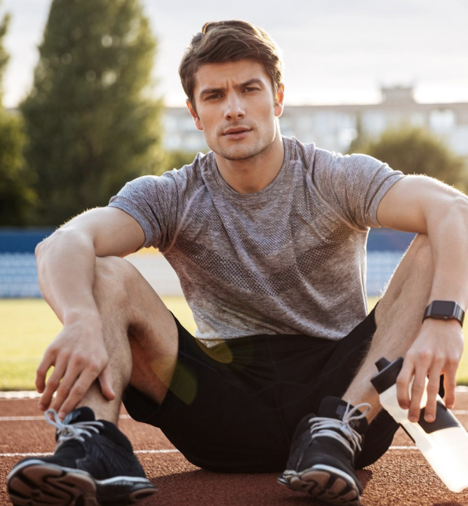
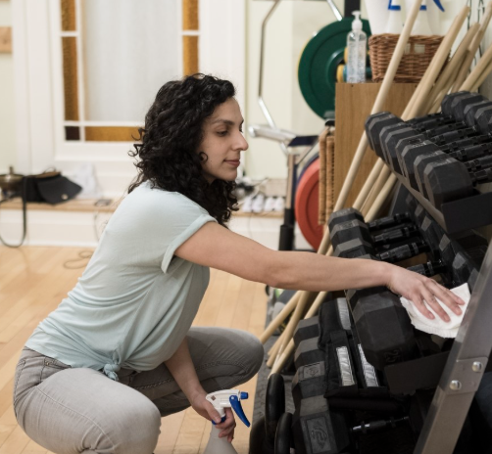

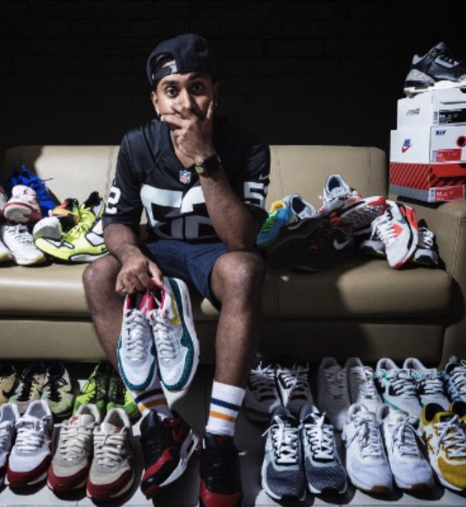
Nike
Anchor TG
Athletes and performance obsessed 25. year-old – Fitness driven, edgy, aspirational
User TG
Gym goers, casual walkers, Kids, sneaker heads, Fashion conscious, etc.

Slide 7
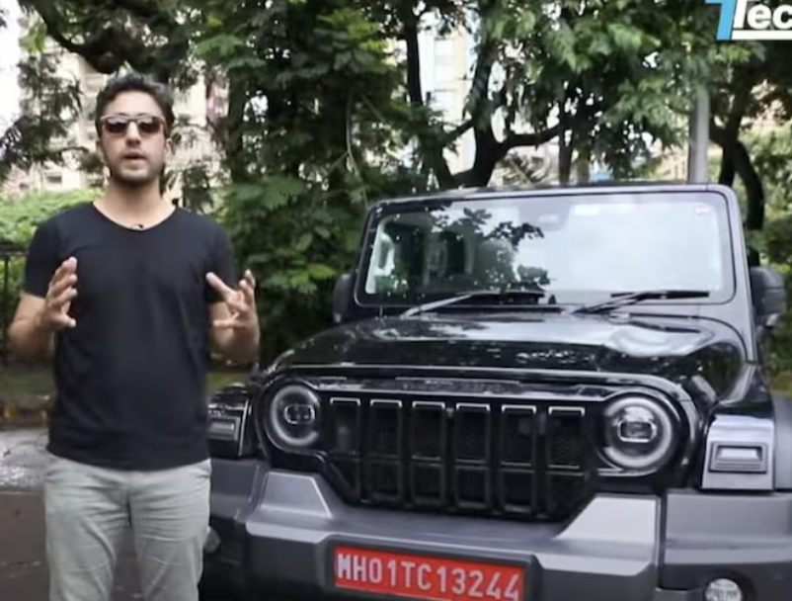

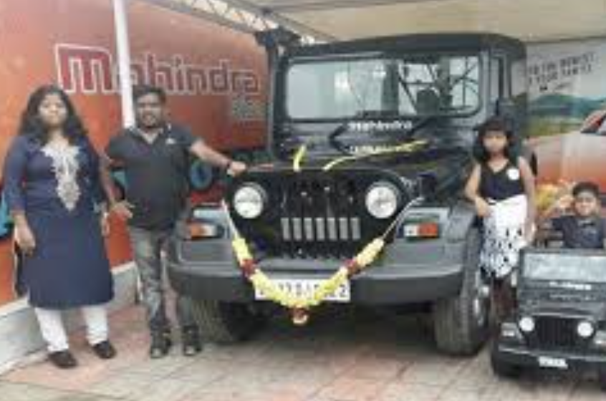
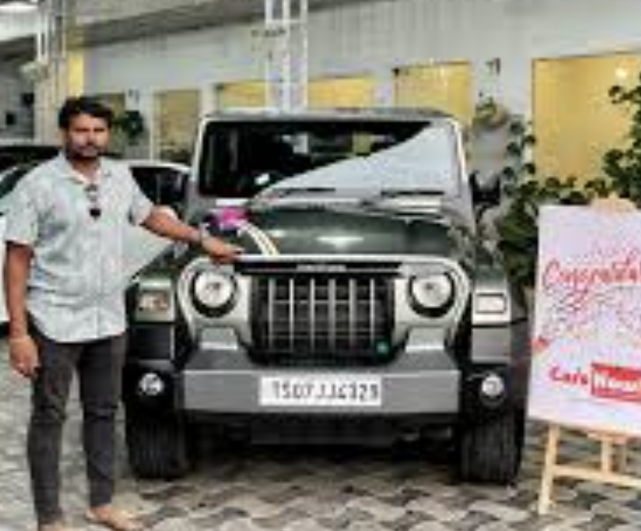
Thar
Anchor TG
Young Male Explorers, Urban Adventurers- Strong sense of freedom, self expression
User TG
Working professional, families from Tier 2 , Men in their 40s buying into a youth fantasy

Slide 8

TG of Epigamia
Communication TG – M/F, 28, Metro, NCCSA Bold, Ambitious, Lifestyle & Convenience Seeker
User TG – 5cr. Consumers, 18-60 in the top 50 towns
Notes:
Useful Links –
NCCS Data - https://www.afaqs.com/news/media/42980_a-dummys-guide-to-nccs
In India, Socio-Economic Classification (SEC) is a widely used system to segment households and consumers. It’s not just about income, but also about education of the chief wage earner (CWE) and occupation.
Here’s a snapshot:
1. Old SEC (pre-2011)
Classified households into SEC A1, A2, B1, B2, C, D, E1, E2.
Basis: Education + Occupation of the chief wage earner.
Very urban-centric, not effective for rural segmentation.
2. NCCS (2011 onwards, used by MRUC & MRSI)
Replaced by NCCS (New Consumer Classification System).
Basis:
Education of chief earner
Ownership of consumer durables (like refrigerator, TV, car, two-wheeler, computer, AC, etc.)
Households are classified into NCCS A, B, C, D, E with sub-grades.
It covers both urban & rural India, making it a more robust classification.
3. The ISEC Replaces NCCS
The New Consumer Classification System (NCCS)—based on the education of the chief wage earner and ownership of specified consumer durables—has been officially replaced. On February 21, 2024, the Market Research Society of India (MRSI) announced the launch of the Indian Socio‑Economic Classification (ISEC) system
Why the Shift?
Better Reflects Societal Changes
NCCS became less effective due to increasing penetration of durable assets across all classes, diluting its discriminatory power. ISEC addresses this limitation. Moneycontrol+7afaqs!+7mrweb.com+7
Includes More Relevant Indicators
Occupation of the chief wage earner
Education level of the most educated adult male
Education level of the most educated adult female
Notably, this is the first classification to actively include women's educational attainment—marking a shift toward gender-equitable metrics. Research Live+12pressinsider.com+12afaqs!+12Storyboard18+2Moneycontrol+2
More Granular Tiering
ISEC uses a refined 12-tier system, compared to NCCS’s fewer broad categories, offering finer segmentation for targeting. Research Live+15pressinsider.com+15mrsi.co.in+15
Robust and Stable
It’s designed to be more stable over time and relevant across both urban and rural contexts without needing frequent revisions. Research LiveFree Press Journal+15afaqs!+15The Economic Times+15

Slide 9
Useful Links –
NCCS Data - https://www.afaqs.com/news/media/42980_a-dummys-guide-to-nccs
In India, Socio-Economic Classification (SEC) is a widely used system to segment households and consumers. It’s not just about income, but also about education of the chief wage earner (CWE) and occupation.
Here’s a snapshot:
1. Old SEC (pre-2011)
Classified households into SEC A1, A2, B1, B2, C, D, E1, E2.
Basis: Education + Occupation of the chief wage earner.
Very urban-centric, not effective for rural segmentation.
2. NCCS (2011 onwards, used by MRUC & MRSI)
Replaced by NCCS (New Consumer Classification System).
Basis:
  Education of chief earner
  Ownership of consumer durables (like refrigerator, TV, car, two-wheeler, computer, AC, etc.)
Households are classified into NCCS A, B, C, D, E with sub-grades.
It covers both urban & rural India, making it a more robust classification.

Slide 10
3. The ISEC Replaces NCCS
The New Consumer Classification System (NCCS)—based on the education of the chief wage earner and ownership of specified consumer durables—has been officially replaced. On February 21, 2024, the Market Research Society of India (MRSI) announced the launch of the Indian Socio‑Economic Classification (ISEC) system
Why the Shift?
Better Reflects Societal Changes
NCCS became less effective due to increasing penetration of durable assets across all classes, diluting its discriminatory power. ISEC addresses this limitation. Moneycontrol+7afaqs!+7mrweb.com+7
Includes More Relevant Indicators
  Occupation of the chief wage earner
  Education level of the most educated adult male
  Education level of the most educated adult female
Notably, this is the first classification to actively include women's educational attainment—marking a shift toward gender-equitable metrics. Research Live+12pressinsider.com+12afaqs!+12Storyboard18+2Moneycontrol+2
More Granular Tiering
ISEC uses a refined 12-tier system, compared to NCCS’s fewer broad categories, offering finer segmentation for targeting. Research Live+15pressinsider.com+15mrsi.co.in+15
Robust and Stable
It’s designed to be more stable over time and relevant across both urban and rural contexts without needing frequent revisions. Research LiveFree Press Journal+15afaqs!+15The Economic Times+15

Slide 11
Defining Anchor TG

Slide 12

Different Consumers!
DEMOGRAPHICS–
Old/young/Mid aged
Metro/ Middle-India/Rural
South/North India
Graduate/10th Pass/Uneducated -- Super Rich/ Middle Class/Poor
Married/Unmarried -- Male/Female/Transgender
PSYCHOGRAPHICS–
Liberal/Conservative
Explorer vs Control
Quality Conscious vs Price Conscious
Individual vs Collective
Restless vs Pragmatic
One size does not fit all!
Non homogeneity of the Consumer
Multilayered and Complex decision process
Seeking different benefit and attaching value to those benefits

Slide 13
Need to Segment the Market
What is a segment?
Marketing task
A distinct group ( sub- group) of consumers, who share a similar set of wants
Identify these segments
… decide which to target ( Targeting)
Two broad variables at play in segmenting
  Descriptive characteristics
  Behavioral characteristics
Tailor marketing programs basis the segmentations
Notes:
Segmentation is the process of breaking down a large, heterogeneous market into smaller, homogeneous groups that share common characteristics and buying behaviors. The goal is not just to classify, but to identify actionable groups that a brand can target with distinct value propositions.
Why do brands segment?
Better consumer understanding – identify needs, motivations, pain points.
Efficient resource allocation – avoid spreading too thin; focus budgets where ROI is high.
Competitive advantage – own a segment before competitors do.
Customization – design products, pricing, distribution, and communication tuned to the segment.
Bases of Segmentation
Demographic: Age, gender, income, occupation, family size.
Ex: LIC has child plans, retirement plans, and women-focused policies.
Geographic: City vs. rural, climate, region, tier of town.
Ex: AC brands like Voltas push heavily in North India summers, while ceiling fan brands dominate in coastal states
.
Psychographic: Lifestyle, aspirations, values, personality.
Ex: Titan Raga watches are marketed as a symbol of modern Indian womanhood — not just “a watch for women.”
Behavioral: Usage occasions, benefits sought, loyalty, readiness to buy.
Ex: Zomato segments consumers into weekday lunch users, late-night partygoers, health-conscious salad customers

Slide 14
Segmentation is the process of breaking down a large, heterogeneous market into smaller, homogeneous groups that share common characteristics and buying behaviors. The goal is not just to classify, but to identify actionable groups that a brand can target with distinct value propositions.
Why do brands segment?
Better consumer understanding – identify needs, motivations, pain points.
Efficient resource allocation – avoid spreading too thin; focus budgets where ROI is high.
Competitive advantage – own a segment before competitors do.
Customization – design products, pricing, distribution, and communication tuned to the segment.
Bases of Segmentation
Demographic: Age, gender, income, occupation, family size.
Ex: LIC has child plans, retirement plans, and women-focused policies.
Geographic: City vs. rural, climate, region, tier of town.
Ex: AC brands like Voltas push heavily in North India summers, while ceiling fan brands dominate in coastal states
.
Psychographic: Lifestyle, aspirations, values, personality.
Ex: Titan Raga watches are marketed as a symbol of modern Indian womanhood — not just “a watch for women.”
Behavioral: Usage occasions, benefits sought, loyalty, readiness to buy.
Ex: Zomato segments consumers into weekday lunch users, late-night partygoers, health-conscious salad customers

Slide 15
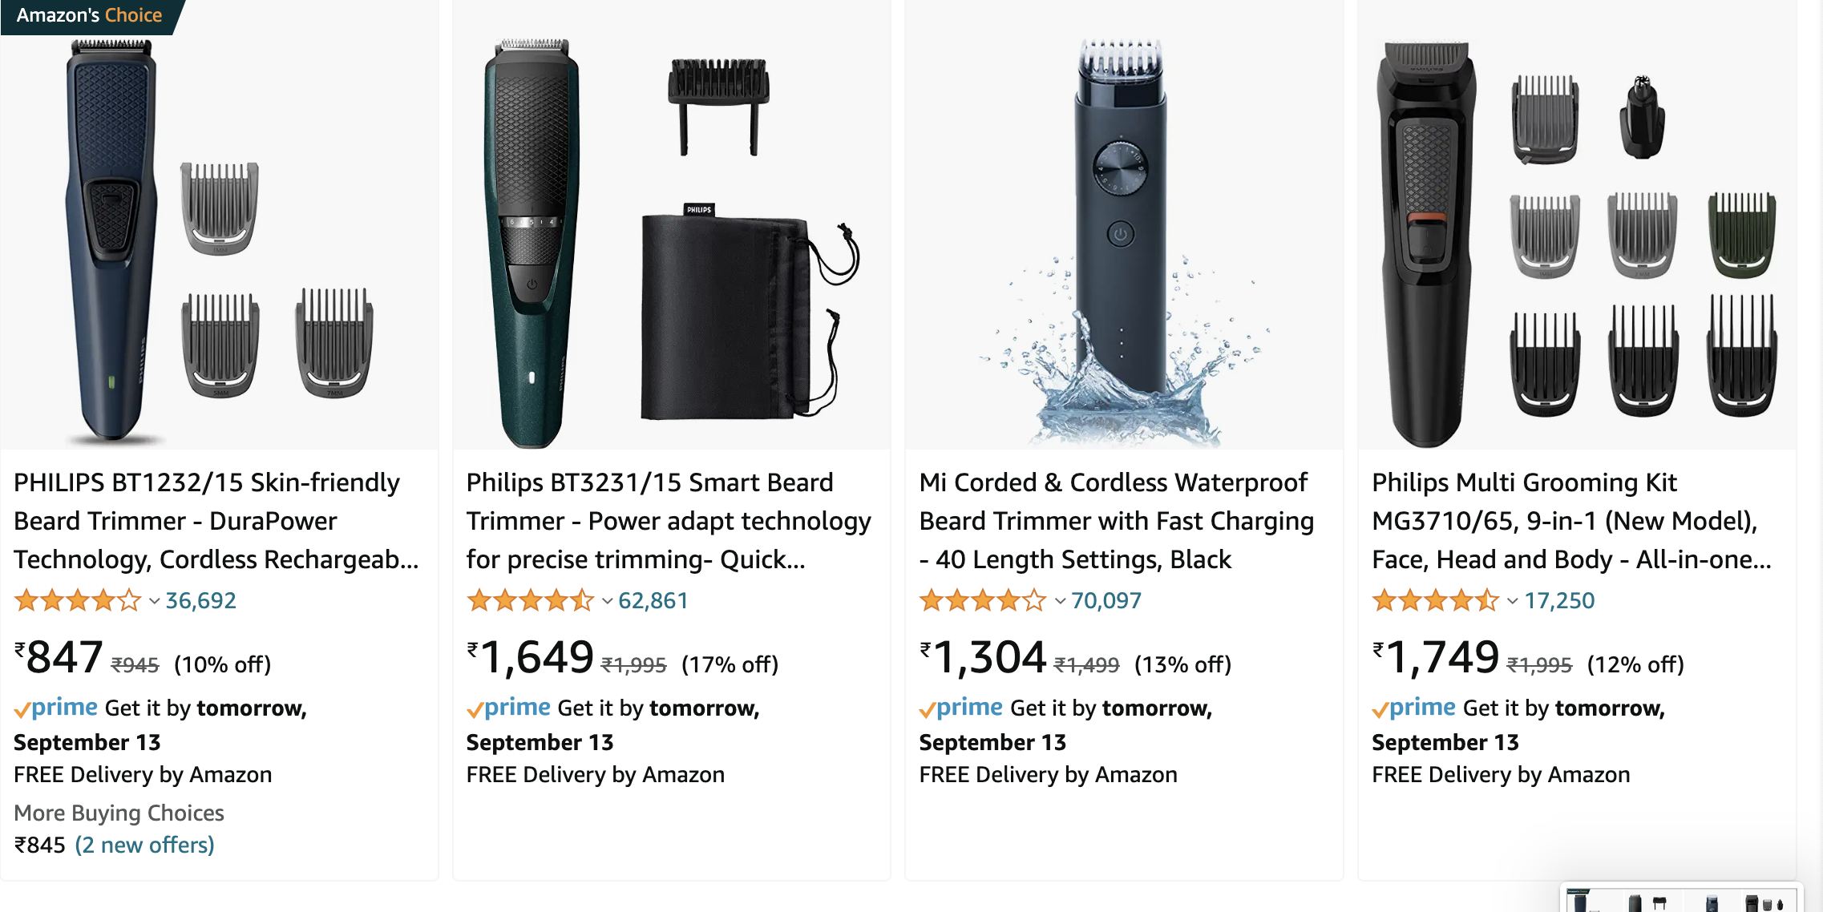
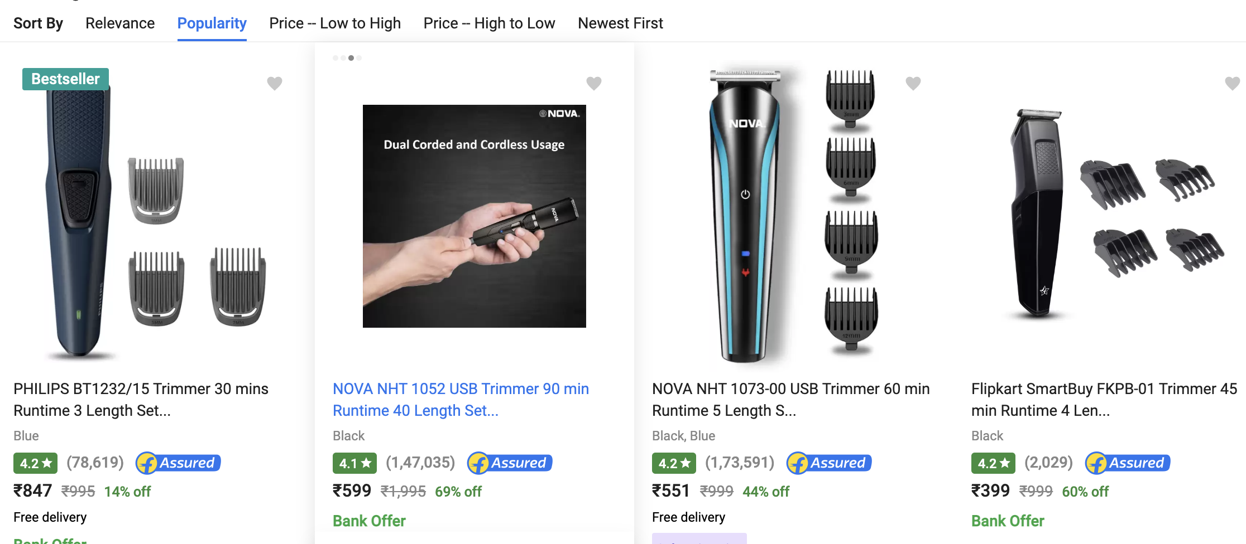
Descriptive Variables
Demographic - Geography
Nation/States/Cities/neighborhoods/pin codes
Town classification/Density – e.g. All villages above 5k population, Urban/Rural.
Amazon
Trimmers is one of the fastest growing categories in India
Category that span across all Urban ( not just metro-centric
Amazon and flipkart’s platform segmentation is very clear when you search trimmers!
The top searches on Amazon are premium high-priced trimmers, whereas that off FK is low priced, local trimmers
Amazon is a platform that focuses on metro/tier 1 segment, FK is Tier 2/3
Philips also focuses it plans based on the segment focus of each platform
Flipkart

Slide 16

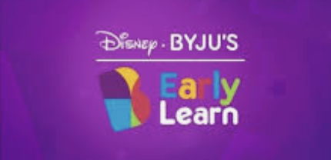
Descriptive Variables
Demographic - Other
Age – 1-6, 6-14, 14-25, 25-38….
Life stage – Teen, DINKs, First jobbers,
Byju’s has offerings tailormade to age/Life stage segments
(1-3 I 4-10, Online Tutoring I JEE/NEET, CAT, IAS)

Slide 17
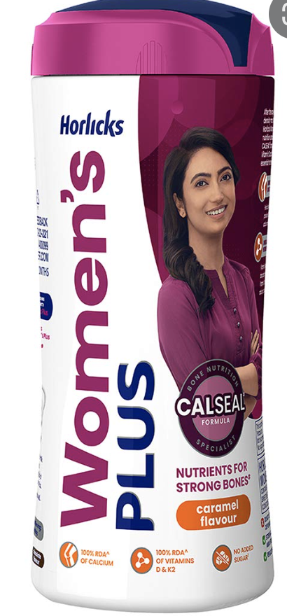
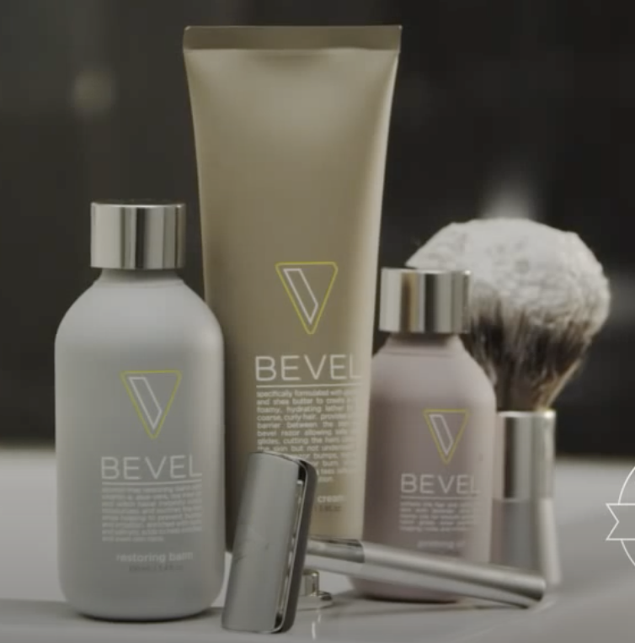
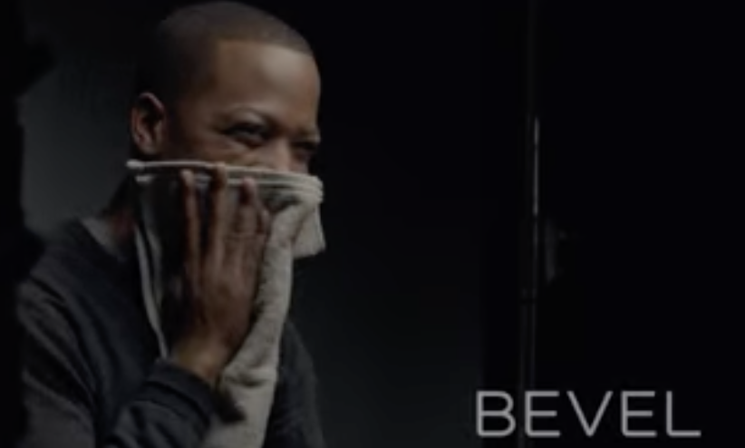
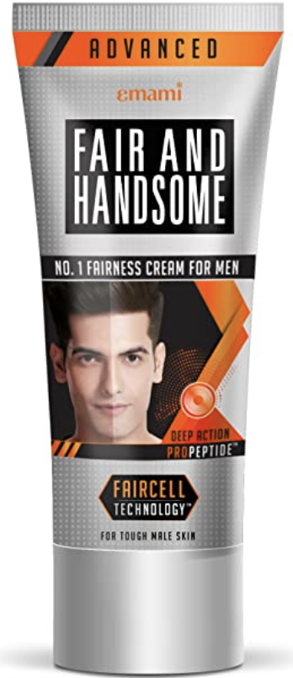


Descriptive Variables
Demographic - Other
Gender- Male/Female
Ethnicity – North/South, Afro –American, etc
CPG focus has moved to segmenting by gender
Many products in the US are targeting Ethnicity- e.g – Bevel , Drive legacy & Culture of Afro - Americans
Notes:
TRIB fashion Store

Slide 18
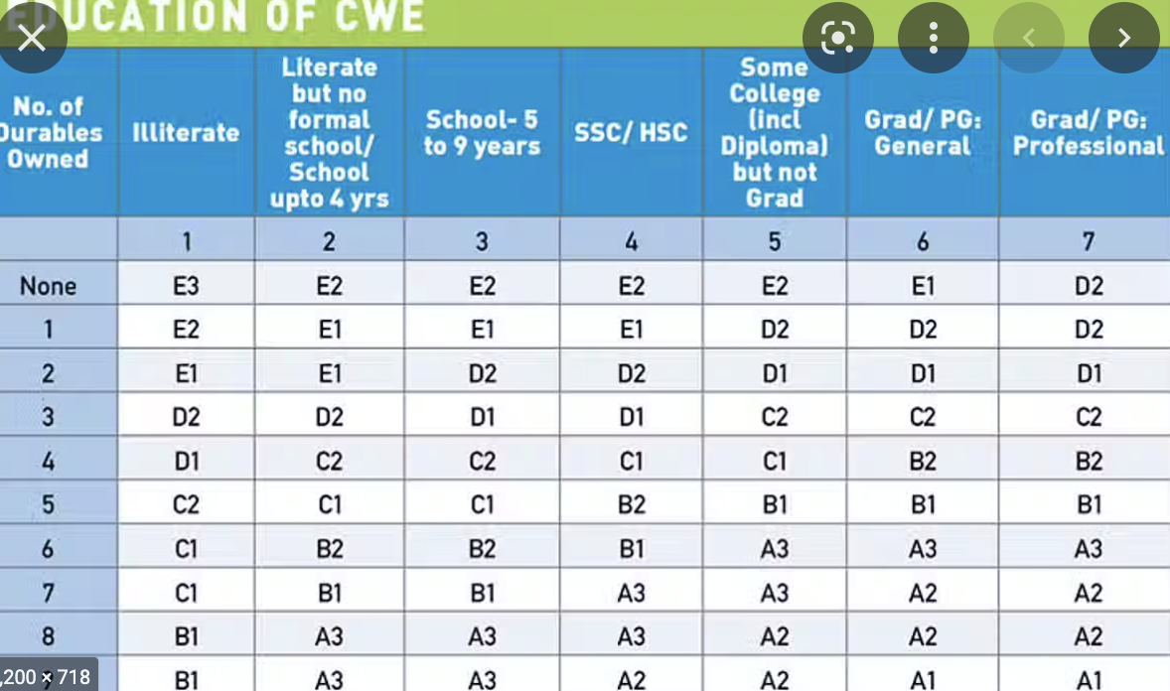
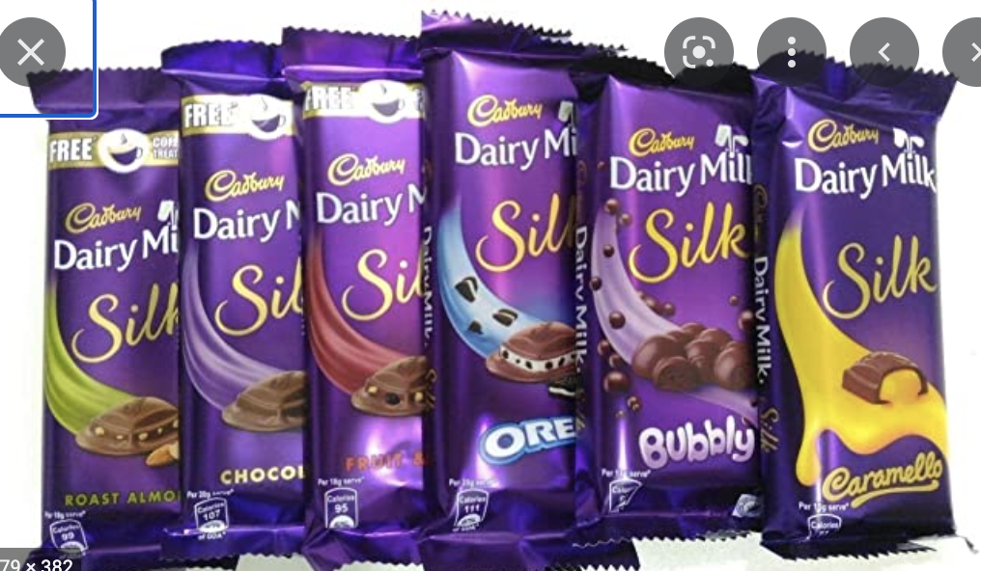
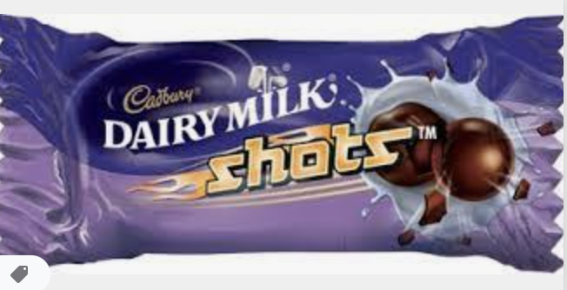
Descriptive Variables
Demographic - Income
Based on Disposable income/spends
Socio Economic Classification- NCCS A/B/C
Cadbury has used Income level Segmentation to diversify its portfolio into Premium offering like Silk and low unit packs like Shots to counter the toffee penetration in Rural
New age starts up are trying to capture the NCCS A/B consumer – Classification based on education and ownership

Slide 19
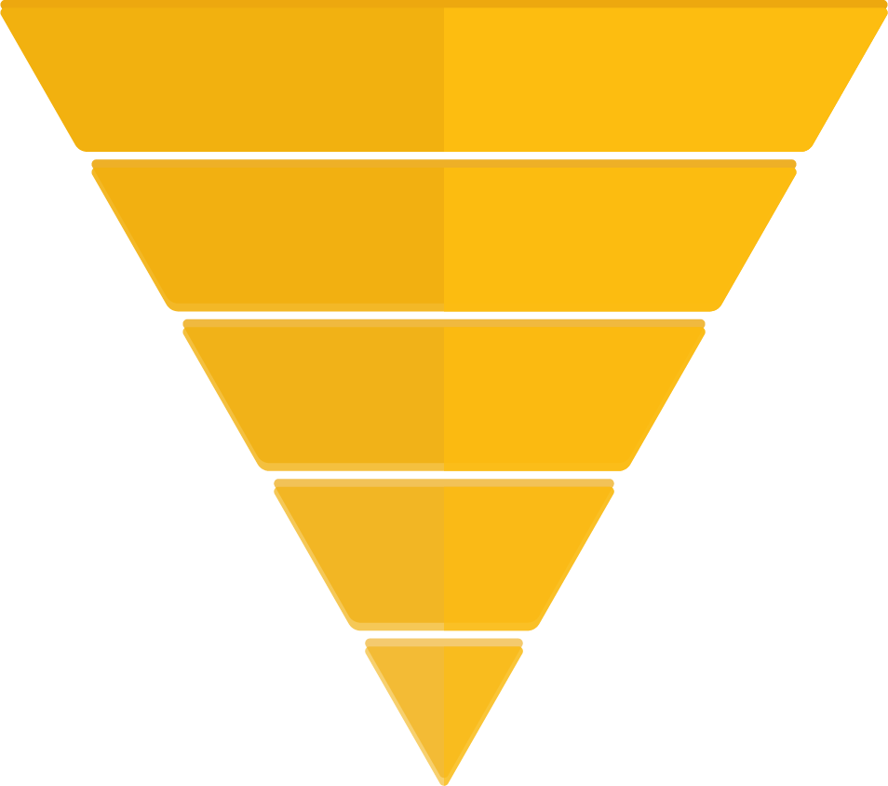
Behavioral Variables
User/Usage Related Parameters
User Status – Current Users vs Lapsers
Usage Rate – Light, Medium and Heavy Users
Readiness/Funnel – Aware, Interested, Tried, Returned, Loyal
Usage Funnels tracked regularly and useful way to segment consumers of category
Aware
Ever Tried
Buy Once a month
Buy Weekly
MOUB
Notes:
TRIB fashion Store

Slide 20
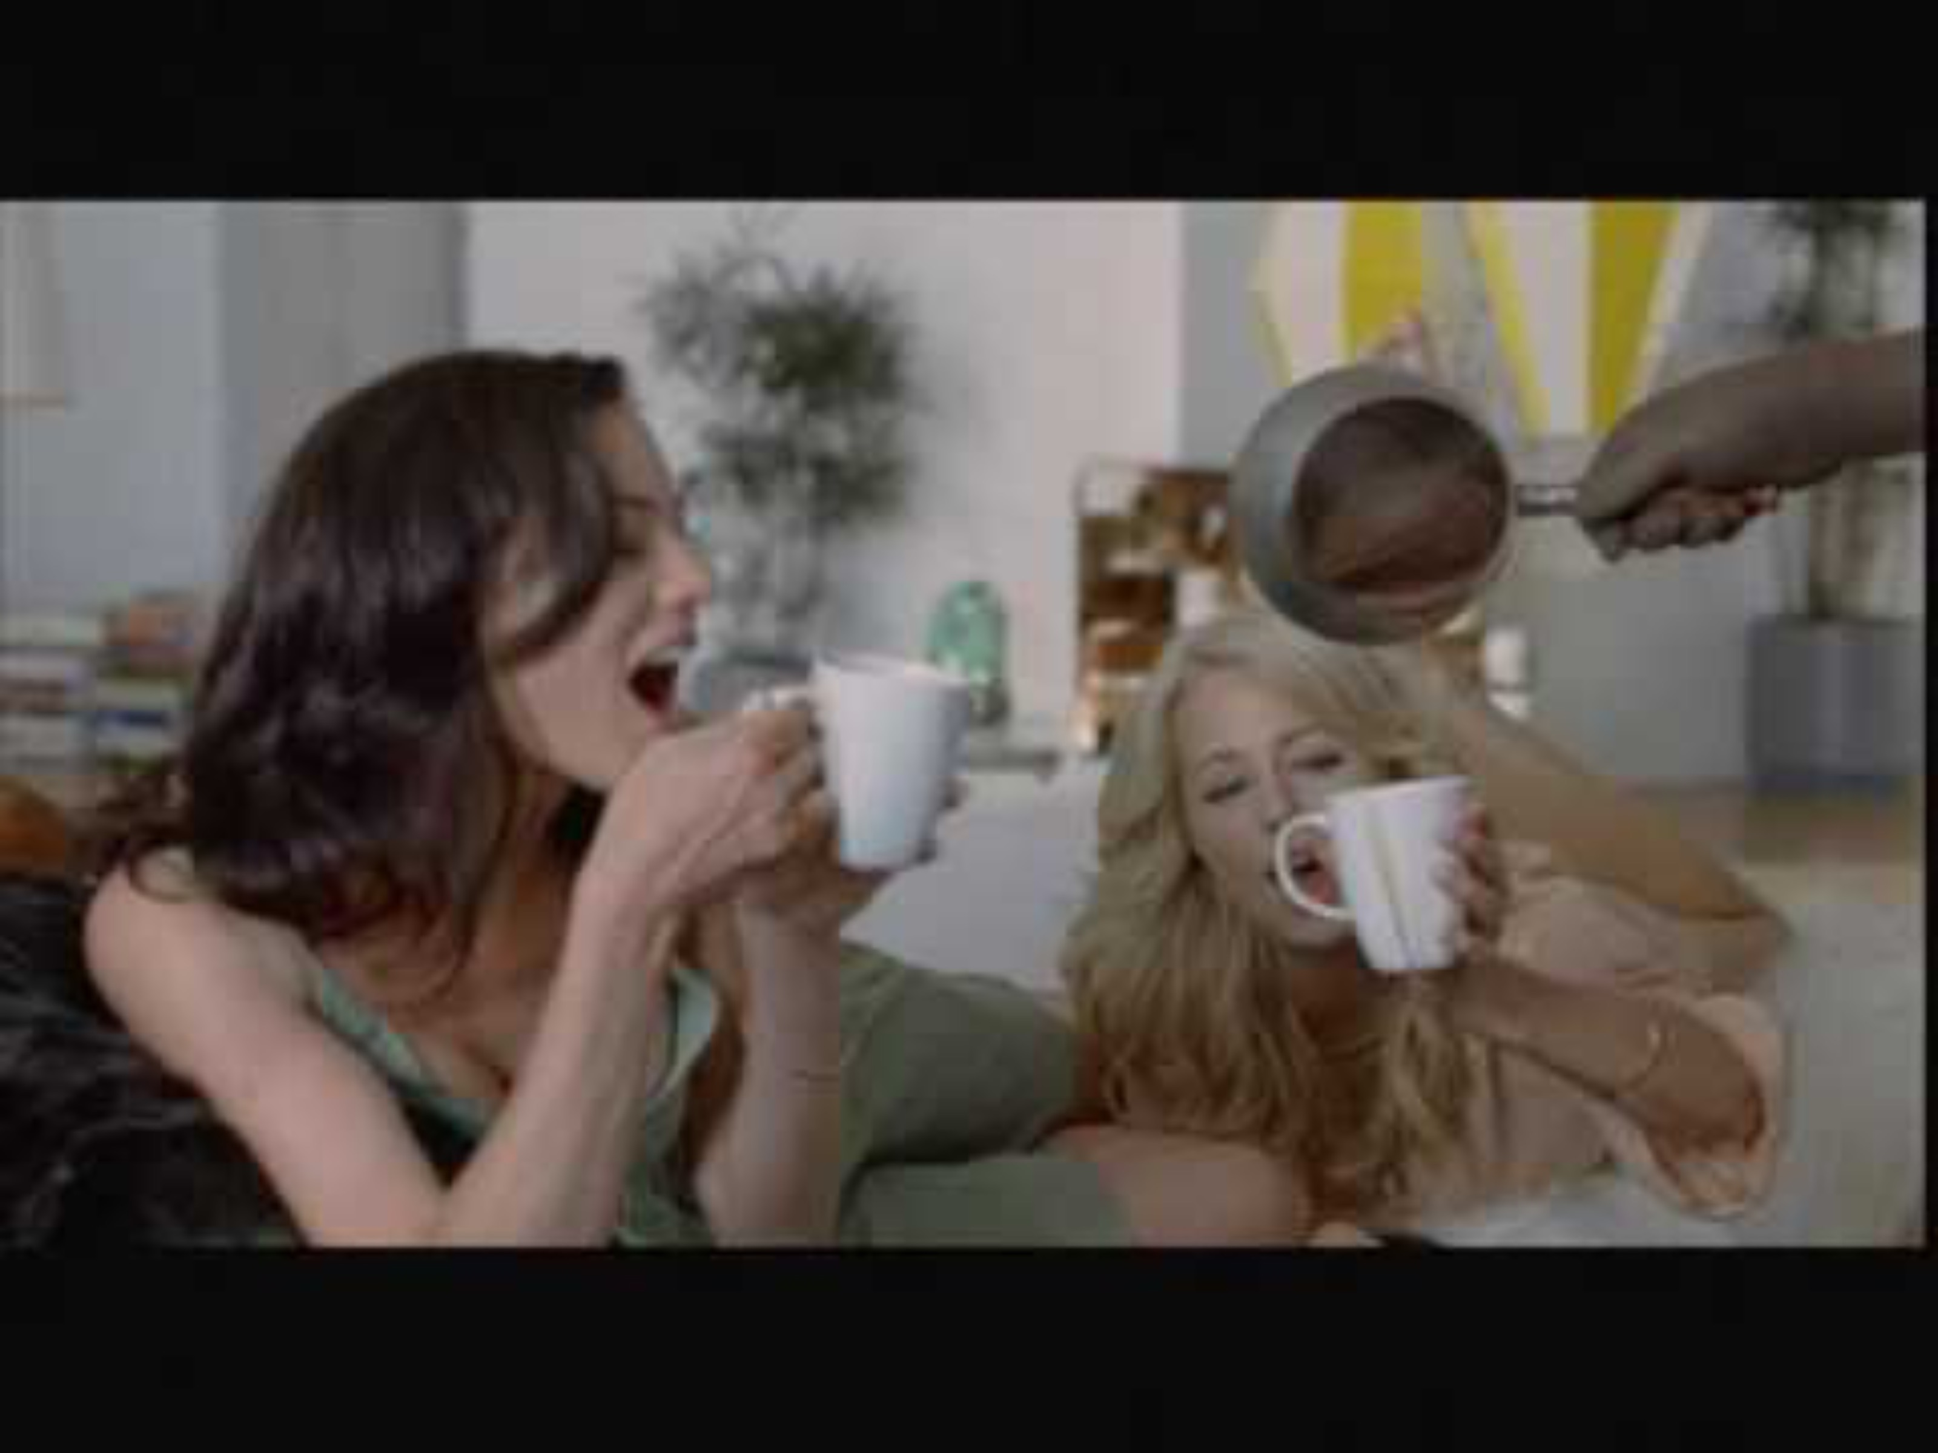
Axe Used Psychographics
To Segment and Target Consumers
Axe positioning is built on understanding the consumer segment and picking one and arriving at pain points on which concept is built
Predator – Who took advantages of his girls
Natural Talent – Athletic, smart and confident
Marriage Material – Humble, respectful, want to introduce his to parents
Always friend – Always hits that glass ceiling
Insecure novice – No clue what he is doing!, awkward, needs help
Enthusiastic Novice – No clue what he is doing, but goes out there, tries valiantly
Notes:
Useful links- https://www.businessinsider.com/axe-advertising-unilever-brandwashed-2011-10
0:31
Axe broke down its consumers into definite psychographics profiles
Predator – Who took advantages of his girls
Natural Talent – Athletic, smart and confident
Marriage Material – Humble, respectful, want to introduce his to parents
Always friend –
Insecure novice – No clue what he is doing!, awkward, needs help
Enthusiastic Novice – No clue what he is doing, but goes out there, tries valiantly

Slide 21
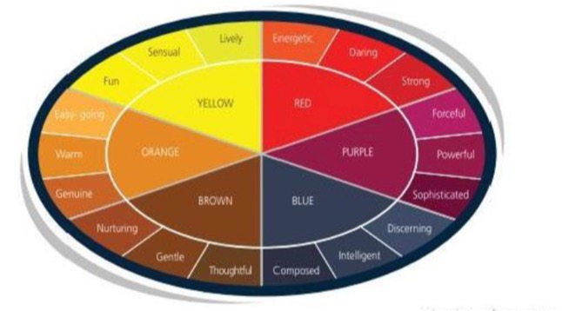
Segmenting basis psychographics - Needscope
A powerful tool for mapping consumer psychographics, emotional need states and brand positioning.
Helps brands identifying deeper emotional drivers behind consumer choices
Tool to building emotionally relevance
Notes:
Each state reflects a deep human motivation that brands can connect with
1. Control - Blue
Core need: Order, structure, safety, reliability.
Consumer psychographics:
Risk-averse, rational decision-makers.
Value security, trust, and performance over novelty.
“Planner” personality – wants to make the right choice.
Examples:
Insurance brands (LIC) appeal to control → “Zindagi ke saath bhi, zindagi ke baad bhi.”
Detergents like Surf Excel (premium moms) — reassurance of quality and care.
2. Comfort - Brown
Core need: Belonging, reassurance, emotional warmth.
Consumer psychographics:
Family-centric, tradition-respecting, loyal.
Nostalgia-driven, prefer known trusted brands.
“Caregiver” personality – seeks connection and harmony at home.
Examples:
Cadbury Dairy Milk → “Kuch Meetha Ho Jaaye” tied to family rituals.
Amul → evokes warmth, familiarity, everyday comfort.
3. Harmony - Orange
Core need: Balance, well-being, fitting in with community.
Consumer psychographics:
Socially conscious, cooperative, affiliative.
Seek moderation, sustainability, holistic living.
“Community seeker” personality – avoids extremes, seeks consensus.
Examples:
FabIndia → rooted, ethnic, socially conscious clothing.
Organic India teas → balance of health, nature, and community values.
4. Liberation - Yellow
Core need: Freedom, spontaneity, breaking away from norms.
Consumer psychographics:
Young, experimental, live-in-the-moment.
Reject authority, embrace fun and flexibility.
“Free spirit” personality – wants choices without restrictions.
Examples:
Mountain Dew → “Dar ke aage jeet hai.”
Zomato’s cheeky, irreverent marketing tone.
5. Potency/Energy - Red
Core need: Power, achievement, mastery, status.
Consumer psychographics:
Ambitious, competitive, aspirational.
Driven by success markers, visible symbols of achievement.
“Achiever” personality – wants to be seen as a winner.
Examples:
Royal Enfield → “Jab bullet chalta hai, duniya raasta deti hai.”
Rolex / premium single malts — signifiers of power and prestige.
6. Indulgence - Purple
Core need: Pleasure, enjoyment, escape, sensory gratification.
Consumer psychographics:
Fun-seeking, hedonistic, want to enjoy the now.
Indulge in treats, luxury, and experiential consumption.
“Pleasure seeker” personality – buys things to feel good.
Examples:
Maggi → comfort indulgence, quick guilty pleasure.
Starbucks → more than coffee, an indulgent experience.
Premium chocolates (Ferrero Rocher, Lindt) in India.
Case study - https://www.cbs-axa.md/img/st_img/PDF/pr/NeedScope_CaseStudies.pdf?

Slide 22
Each state reflects a deep human motivation that brands can connect with
1. Control - Blue
Core need: Order, structure, safety, reliability.
Consumer psychographics:
  Risk-averse, rational decision-makers.
  Value security, trust, and performance over novelty.
  “Planner” personality – wants to make the right choice.
Examples:
  Insurance brands (LIC) appeal to control → “Zindagi ke saath bhi, zindagi ke baad bhi.”
  Detergents like Surf Excel (premium moms) — reassurance of quality and care.
2. Comfort - Brown
Core need: Belonging, reassurance, emotional warmth.
Consumer psychographics:
  Family-centric, tradition-respecting, loyal.
  Nostalgia-driven, prefer known trusted brands.
  “Caregiver” personality – seeks connection and harmony at home.
Examples:
  Cadbury Dairy Milk → “Kuch Meetha Ho Jaaye” tied to family rituals.
  Amul → evokes warmth, familiarity, everyday comfort.

Slide 23
3. Harmony - Orange
Core need: Balance, well-being, fitting in with community.
Consumer psychographics:
  Socially conscious, cooperative, affiliative.
  Seek moderation, sustainability, holistic living.
  “Community seeker” personality – avoids extremes, seeks consensus.
Examples:
  FabIndia → rooted, ethnic, socially conscious clothing.
  Organic India teas → balance of health, nature, and community values.
4. Liberation - Yellow
Core need: Freedom, spontaneity, breaking away from norms.
Consumer psychographics:
  Young, experimental, live-in-the-moment.
  Reject authority, embrace fun and flexibility.
  “Free spirit” personality – wants choices without restrictions.
Examples:
  Mountain Dew → “Dar ke aage jeet hai.”
  Zomato’s cheeky, irreverent marketing tone.

Slide 24
5. Potency/Energy - Red
Core need: Power, achievement, mastery, status.
Consumer psychographics:
  Ambitious, competitive, aspirational.
  Driven by success markers, visible symbols of achievement.
  “Achiever” personality – wants to be seen as a winner.
Examples:
  Royal Enfield → “Jab bullet chalta hai, duniya raasta deti hai.”
  Rolex / premium single malts — signifiers of power and prestige.
6. Indulgence - Purple
Core need: Pleasure, enjoyment, escape, sensory gratification.
Consumer psychographics:
  Fun-seeking, hedonistic, want to enjoy the now.
  Indulge in treats, luxury, and experiential consumption.
  “Pleasure seeker” personality – buys things to feel good.
Examples:
  Maggi → comfort indulgence, quick guilty pleasure.
  Starbucks → more than coffee, an indulgent experience.
  Premium chocolates (Ferrero Rocher, Lindt) in India.
Case study - https://www.cbs-axa.md/img/st_img/PDF/pr/NeedScope_CaseStudies.pdf?

Slide 25
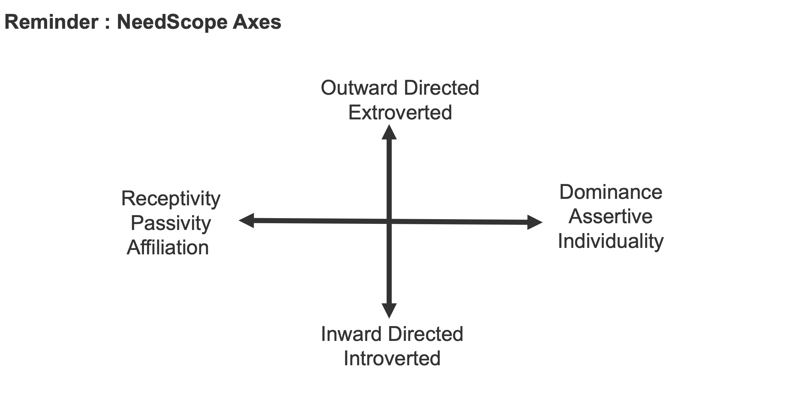

Slide 26
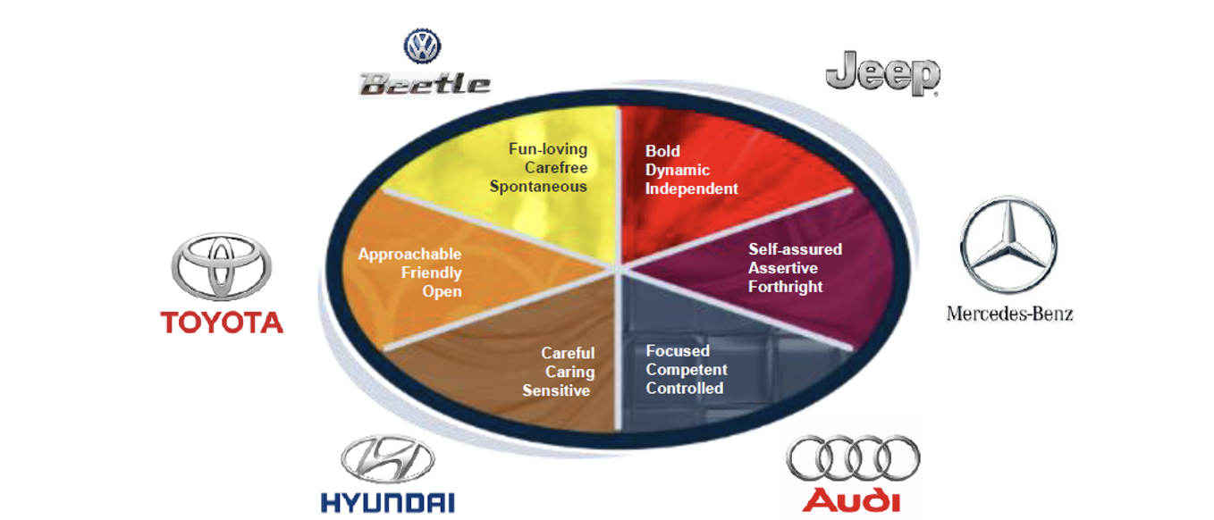
Segmenting basis psychographics - Needscope
A powerful tool for mapping consumer psychographics, emotional need states and brand positioning.
Helps brands identifying deeper emotional drivers behind consumer choices
Tool to building emotional relevance

Slide 27
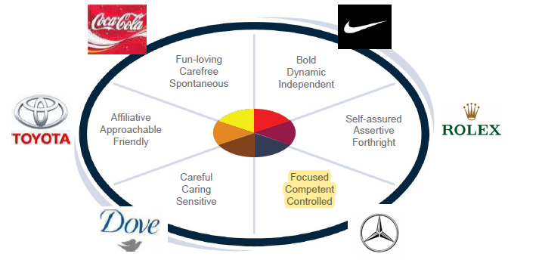
Needscope - Examples

Slide 28
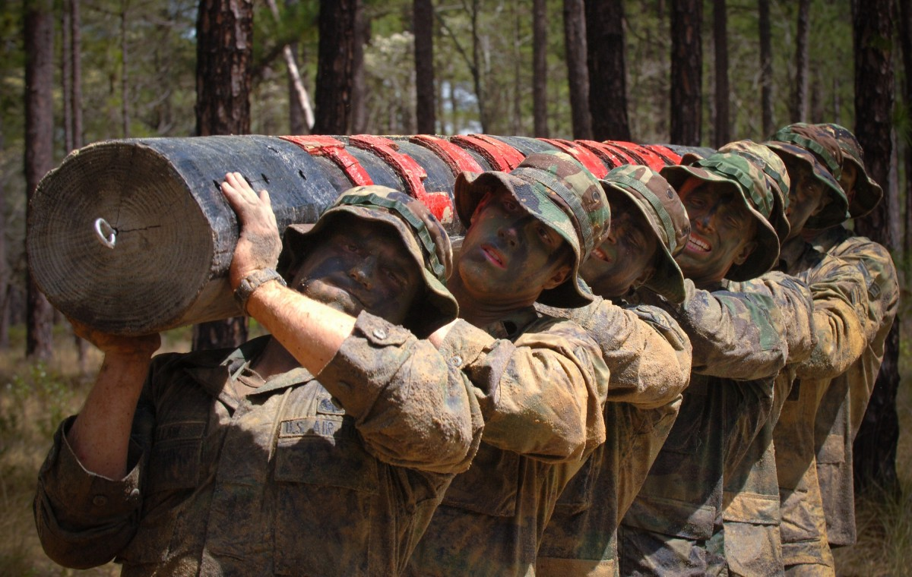
Segmentation Exercise – Exercise 6
Group Activity
You will be given 3 personas for Sugar Cosmetics
Your task
Plot these persona on the Needscope framework
Pick the recommended Target Consumer for Sugar
Time – 15 minutes
Be ready to Share

Slide 30
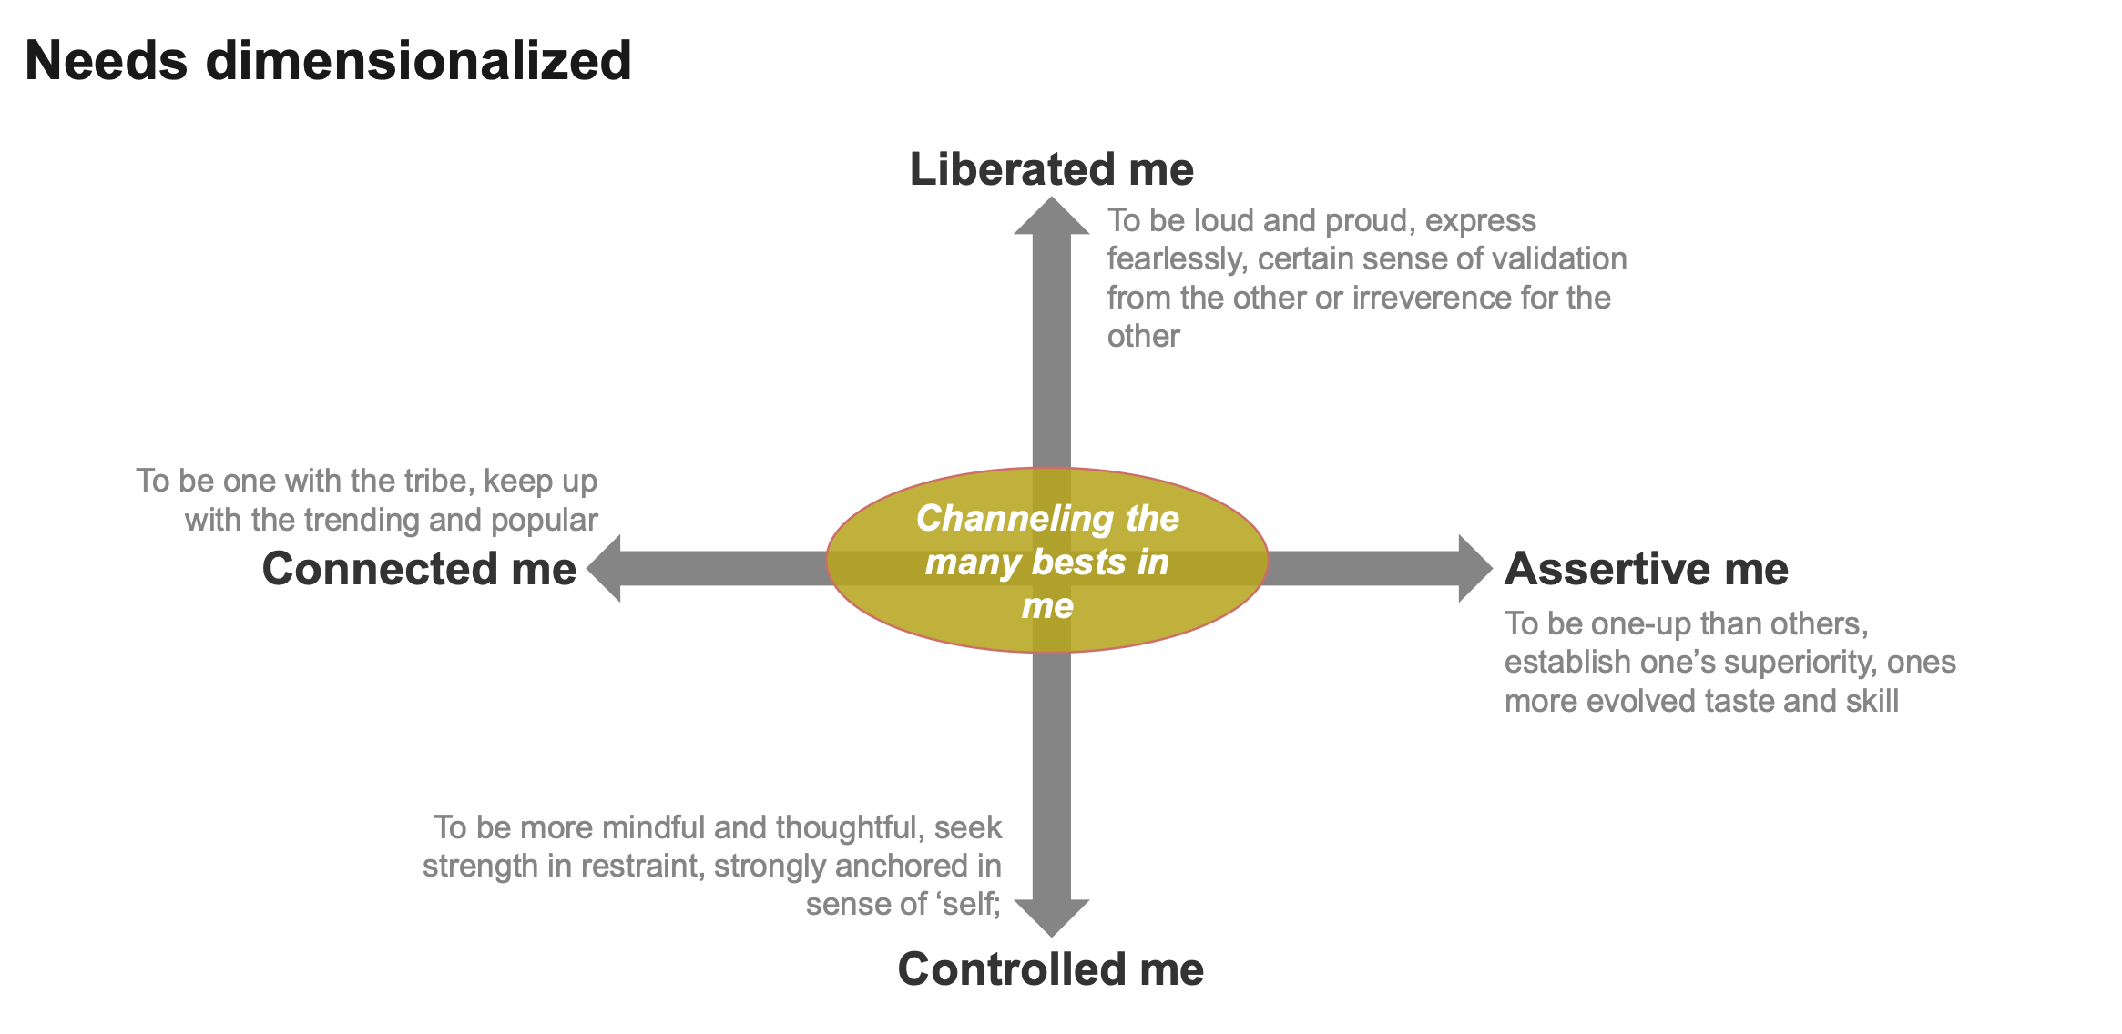

Slide 31
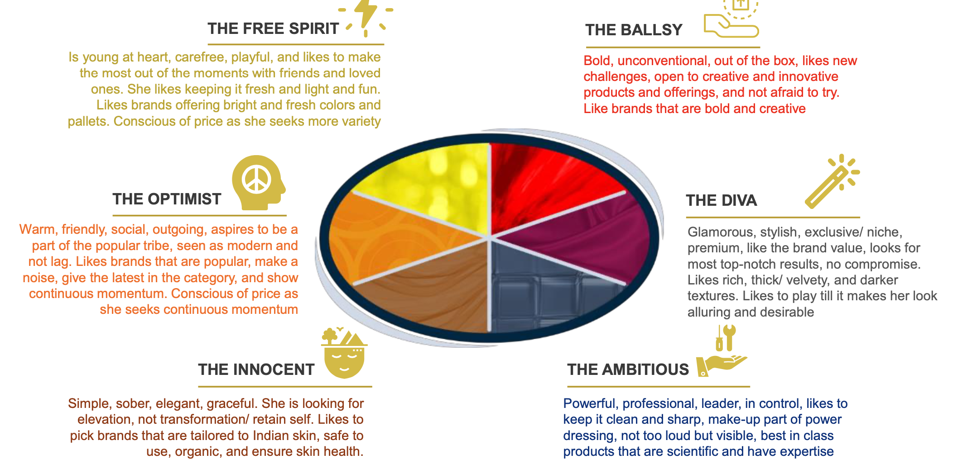

Slide 32
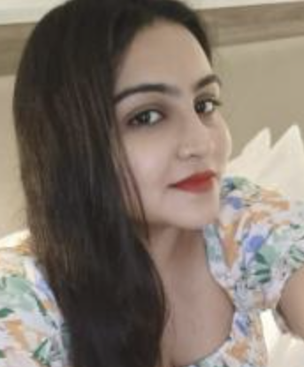
Meet Neha
Demographic
Age – 26
Born – Gorakhpur,
Parents – Dad –Retail shop. Mom Housewife
Profession – First jobber, Digital marketing Agency
City of Residence - Delhi
NCCS – B
Aspirations
Want to move to creative side in the Agency
Buy a car
Road Trip of India
Stay Young
Buy a house in Delhi and move Parents
Marriage – 30 is ideal, but may end up earlier, thanks to mamma’s push!
Needs, Wants, Interest & Hobbies
Friends & Family
On trend fashion style
Reading
Social media + streaming
Hangout with Friends
Core Values
Perpetual Seeker
Rooted
Explorer
Authentic
What do Friends & Family Say about her
Parents – Ambitious, Loving
Uncle & Aunts – Free spirited, Loving
Friends – Dreamer, Approachable, Fun loving
Colleagues – Reliable, Fun Loving
Attitude about Category (Color cosmetics)
Use Make Up everyday
Fun and trendy Shades – Ability to Explore
Wants Make up to keep her glow and shine and last long and look casual ( Fun)
Glamour is not core to her and does not believe using make up is critical to success

Slide 33
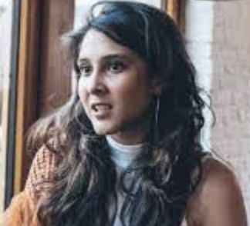
Meet Lavani
Demographic
Age – 30
Born – Mumbai
Parents – Dad – Branch head in Bank, Mom – Teacher
Profession – Co- Founder of Stealth Start up. Ex- Marketeer
Married, His name is Dhruv
City of Residence - Mumbai
NCCS – A
Aspirations
Wants to make her Start up a Unicorn!
Start a Basketball league for women
Set up a Mission & Podcast for Driving DEI @ education Institution.
Will have a child, when she is ready! And will be Soon
Annual getaways, with a twist!
Core Values
Individualistic
Be Bold
Freedom
Push Boundaries
Authenticity
Needs, Wants, Interest & Hobbies
Friends ,Family & Partner
Basketball, Fitness
Fashion - Anything Bright!
Social media + streaming
Attitude about Category (Color cosmetics)
Use Make Up everyday
Bold & Unique Shades
Wants Make up to portray the best side of her,
helps to accentuate herself and make a statement
What do Friends & Family Say about her
Parents – Bold, Go getter, Action Seeker
Uncle & Aunts – Creative, brave,
Friends – Problem Solver, Energy of the Party
Colleagues – Unhinged, Daring,

Slide 34
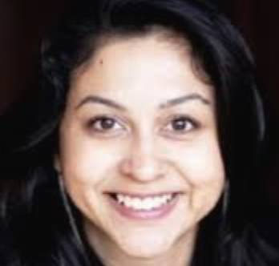
Meet Aisha
Demographic
Age – 35
Born – Mumbai
Parents – Dad – Retired, Consultant. Mom –CEO of IT company
Profession – Associate Partner, Law Firm.
Married, One child 5 years
City of Residence - Delhi
NCCS – A
Aspirations
Wants to become Partner Soon
Run the 21km under 2 hours
Retire @ 45 and Work on women Rights through Public Policy
Perform on National stage through dance
Wants child to be educated under Liberal Arts
Core Values
Individualistic
Freedom + Responsibility
Imagination
Brutal Honesty
Create Impact/Transformation
Needs, Wants, Interest & Hobbies
Friends & Family
Fitness, Yoga
Fashion, ahead of trend!
Social media + streaming
What do Friends & Family Say about her
Parents – Stubborn, Always there for us!
Uncle & Aunts – Assertive, A mind of her own
Friends – Dynamic, Forceful and Energetic
Colleagues – Get shit done. Change Agent, Tough but Fair
Attitude about Category (Color cosmetics)
Use Make Up everyday
Bold + Muted Shades that work for her
Wants Make up to portray the best side of her
helps to accentuate herself.
Quality is super Important

Slide 35
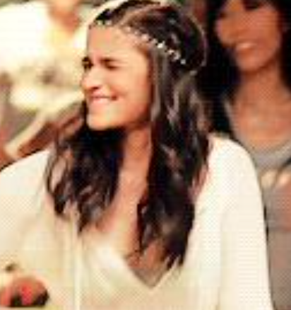
Neha, Free Spirit
Lavani, Ballsy
Aisha, Ballsy
NCCS B, C
NCCS A
NCCS A
25-35
25-35
35-45
Need State - Liberation
Need State – Potency - Energy
Need State – Potency - Assertive
Core value - Rooted & Restless
Core value –Be limitless
Core value –Freedom + Responsibility
Payoff – Journey, Fun
Payoff – Self Expression
Payoff – Performance

Slide 36

Lets have a look at this ad!
Notes:
https://www.linkedin.com/pulse/brand-stories-how-consumer-insight-helped-pampers-beat-sombit-roy

Slide 37
Trivia – Where does the Bournvita mother sit?

Slide 38
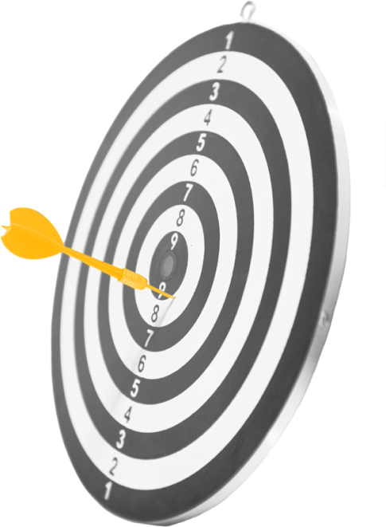
Once you have segmented…..now it is about making a Choice….
Choosing the Target Market…..Targeting!
Notes:
TRIB fashion Store

Slide 39

Targeting
WHAT IS TARGETING
WHAT IS TARGET MARKET
Selecting one or more segments
at which the marketing programs
of the company will be directed,
so as to meet the needs of those specific segments
The segment(s) that a firm selects to turn into consumers
Notes:
TRIB fashion Store

Slide 40
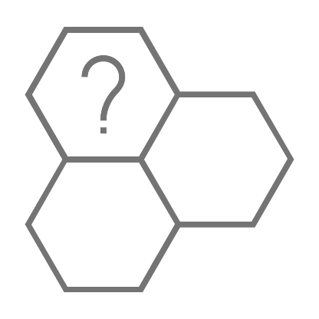


Selecting Segment
EXTERNAL FACTORS
INTERNAL FACTORS
Segment growth/Potential
Competition
Entry/Exit barriers
Substitutes
Bargaining Power of Buyers or Suppliers
Vision/Mission/Purpose
Competencies
Resources
Internal Competency

Slide 41
Pen Portrait of Your Consumer
Bringing your consumer to life – A detailed pic of your ideal consumer
Demographics
Needs, Wants
Motivation, Attitudes, Behavior
Interest, Hobbies
Core Values
Symbols, Icons
Why is this important?
Insights
Gaps/Opportunities/Pain Points
Core to Marketing Mix
Stakeholder Alignment
How to create one?
Research
Detailed Note
Pen Portrait
Core Values
Notes:
TRIB fashion Store

Slide 42
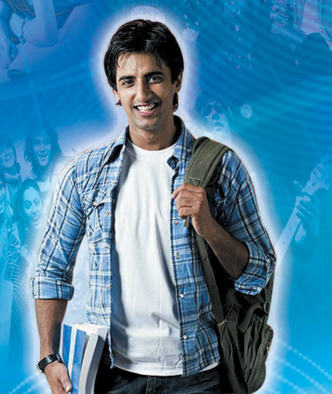
Pen Portrait of Aditya
Demographic
Age – 21
Profession – Student, Last year college. Part time freelance over the weekend
City – Bangalore
NCCSA
Aspirations
Alternate Profession
Car
Road Trips
Friend for Life
Attitude about Category ( Deo)
Funny ads, but why is all about sex
Deos is not about confidence, have all of it
Just need it to last and odour is not an impediment
Needs, Wants, Interest & Hobbies
Alternative profession – Photographer
Friends & Family
Fashion Style, very personal
Gaming & Sports
Loves Travel & Adventure
Core Values
Individualistic
Perpetual Seeker
Rooted
Social Recognition
Sense of Purpose
Day in the life
Hang outs
Gym
Entertainment
Gaming
Photography
Social Media

Slide 43
Core Values - A core value is a deeply held belief about what matters most in life. It guides how a person thinks, behaves, and makes choices—even in small things like what brand to buy.
Have it all….want it all
Fear of missing out
Always assessing on what is missing
Desire to Upgrade
Trend setter
Peer affirmations
Multiple gangs
Mentorship that is always on with friends
Individualistic
Perpetual Seeker
Rooted to Family
Social Recognition
Sense of Purpose
Delayed adult milestones
“so much more to do in my life”
Staying away from home
Disinterested in long standing institutions – E.g – Religion
Career oriented
Writing his own rules
Always plugged in with family
Seeks support and advice from parents
Demands ethics from his relationships be it friends or work
Wants to help out ….contribute back to the society

Slide 44
Exercise - 7
Make a Pen Portrait of Mother for a new MOMS Appliance Company – Core product Breast pumps

Slide 46
Shape the world around me
Connection & Shared Experiences
Channeling the best in me
Autonomy & Self Direction
Safeguard what matters most

Slide 47
Shape the world around me
Exploration
Mastery
Connection & Shared Experiences
Belonging
Channeling the best in me
Recognition
Autonomy & Self Direction
Comfort
Security
Safeguard what matters most

Slide 48
Exploration- The need to experience freedom, novelty and possibility. People in this state are driven by curiosity and a desire to break away from routine. They seek new ideas, places, experiences and perspectives that broaden their horizons and make life feel richer. They value brands that inspire discovery, encourage experimentation and help them embrace the unknown.
Mastery- need to shape one's own life through capability, confidence and agency. People in this state are motivated by the desire to grow, improve and take charge of outcomes rather than be constrained by circumstances. They derive satisfaction from developing skills, overcoming challenges and unlocking their potential. They seek products, services and experiences that empower them to perform better, make smarter decisions and live life on their own terms.
Belonging- The need to build meaningful relationships and feel connected to others. People in this state value companionship, shared experiences and a sense of community. They seek acceptance, emotional closeness and mutual support, gravitating towards brands that strengthen relationships and foster togetherness.
Recognition- The need to express individuality and be seen for who one is. People in this state seek self-expression, appreciation and social affirmation. They use products and experiences to communicate identity, celebrate achievements and create memorable moments. They are drawn to brands that help them stand out, feel special and reinforce their sense of self.
Comfort- The need for emotional and physical ease, reassurance and wellbeing. People in this state seek calm, warmth and relief from stress or uncertainty. They value familiarity, care and environments that help them feel safe, restored and at peace. Brands that reduce friction, provide reassurance and create moments of comfort naturally resonate here.
Security- The need for stability, certainty and control over one's life. People in this state are motivated by reducing risk, protecting what they value and preparing for the future. They seek predictability, reliability and confidence in their decisions, preferring brands that inspire trust, minimise uncertainty and help them feel in control.

Slide 49
Exercise - 7
Plot Specific Brand Consumers of Mom Care Products in following needscope
Orimi, Moms Co, Medela, Earth Mama & Pro MOM
HINT – watch ads, read websites and see packaging to identify key motivations of a mother they are focusing on
Which psychographic is the potential whitespace and then make a pen portrait for that consumer

Slide 50
Psychographics
Need State | Core Psychographics
Mastery | Ambitious, self-reliant, capable, determined, growth-oriented, achievement-driven, in-control
Recognition | Expressive, confident, individualistic, status-aware, validation-seeking, identity-conscious, proud
Exploration | Curious, adventurous, open-minded, spontaneous, novelty-seeking, experimental, freedom-seeking
Belonging | Sociable, inclusive, relationship-oriented, collaborative, community-minded, affectionate, affiliative
Comfort | Reassurance-seeking, nurturing, sensitive, ease-seeking, familiar, restorative, emotionally grounded
Security | Cautious, responsible, risk-aware, structured, dependable, certainty-seeking, prepared

